Slide 1
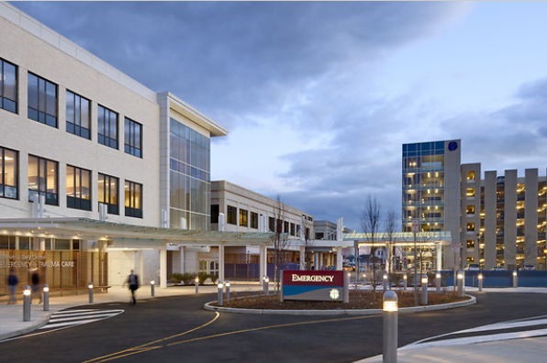


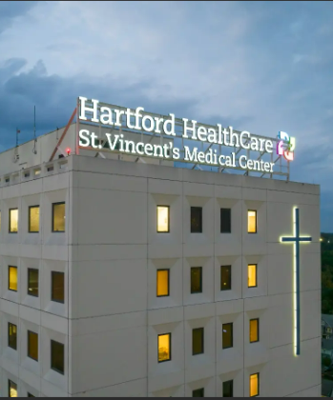
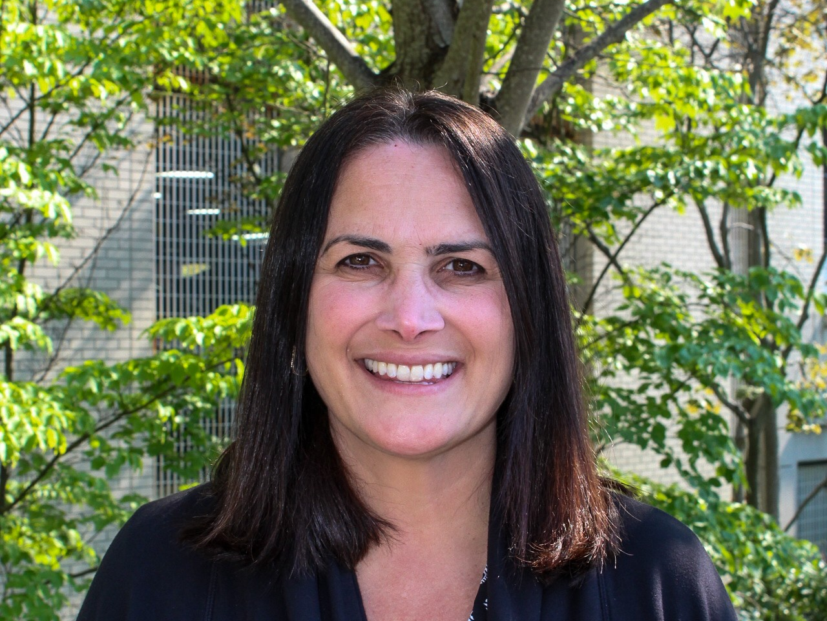

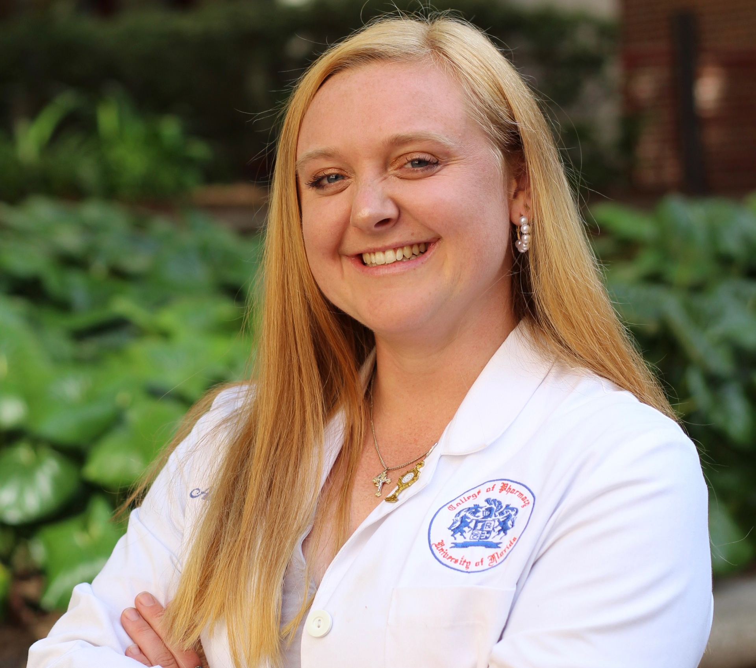


---- Contact Information ----
Residency Program Director
Daniela Markelon
Daniela.Markelon@hhchealth.org
PGY1 Community-Based Resident
Amanda Morningstar
Amanda.Morningstar@hhchealth.org
    St. Vincent’s Outpatient Pharmacy
    2800 Main Street
    Bridgeport, CT 06606
    203-576-5713
St. Vincent’s Medical Center (SVMC) in Bridgeport, Connecticut is a 473-bed community teaching hospital within the Hartford Healthcare system with a level II trauma center, Gold Plus advanced thrombectomy stroke center, and inpatient psychiatric facility. SVMC offers regional centers of excellence in cardiology, surgery, cancer care, orthopedics, diagnostics, family birthing, behavioral health, and a wide array of specialized services.
Guided by its mission to improve the health and healing of all, the SVMC Pharmacy Department is committed to advancing health equity through community outreach. The department operates a charitable Dispensary of Hope pharmacy and organizes an annual statewide medical mission clinic to provide essential medications and healthcare services to underserved members throughout Connecticut.
St. Vincent’s Medical Center Outpatient Pharmacy
Post Graduate Year One (PGY1)
Community- Based Pharmacy Residency

Slide 2
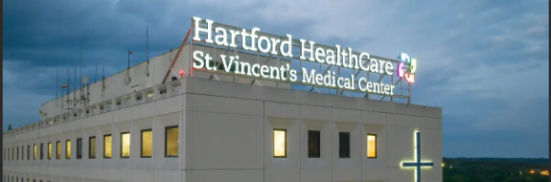
---- Requirements ----
• Eligible for employment in the United States (applicants requiring international visa sponsorship will not be considered)
• Graduate of an ACPE accredited Doctor of Pharmacy Degree Program (or one in process of pursuing accreditation), or have a FPGEC certification from NABP
• Obtain a pharmacist license in CT
• Adhere to the rules of the Residency Matching Program
• Successful completion of a background check and initial employee health screen which includes immunization and drug screen
---- Strong Applicants ----
• Self-directed learner with strong work ethic
• Approaches others with compassion and respect
• Strong verbal and written communication skills
• Values teamwork; able to work in multidisciplinary groups
• Interest in precepting pharmacy students on IPPE/APPE rotations
---- Our Program ----
This ASHP accredited one-year residency program utilizes a systems approach to facilitate the development of new pharmacists into competent practitioners able to provide patient-centered pharmaceutical care. Our program fosters the resident’s ability to work in multidisciplinary teams, develop strong leadership skills, strong verbal and written communication skills and become a lifelong, self-directed learner. The foundation of the program is built upon Hartford Healthcare’s core values of caring, equity, excellence, integrity, and safety.
The resident will attain competency and proficiency in the following areas:
• Patient Care
• Advancing Practice and Improving Patient Care
• Leadership and Management, Teaching, Education, and Dissemination of Knowledge
---- Salary & Benefits ----
• Competitive salary
• Health insurance (medical, dental, vision)
• Paid time off
---- Rotations ----
Block Learning Experiences
• Orientation (5 weeks)
• Population Health (2-4 weeks)
• Endocrinology (4 weeks)
Longitudinal Experiences
* Residents may be required to travel to affiliated sites within the Hartford Healthcare system for certain learning experiences
• Community Pharmacy Practice/Staffing (11 months)
• Every 3rd Saturday for 4-hour shift
  • PTO shifts for staff pharmacists
• Transitions of Care I (Fall 4 months)
• Transitions of Care II (Spring 4 months)
• HOPE Charitable Pharmacy (Spring 4 months)
• Practice Management & Leadership (11 months)
• Research project (11 months)
• Teaching and Learning (11 months)
• Anticoagulation Clinic (Fall or Spring 4 months)
• Ambulatory Care (Fall or Spring 4 months)
• Medical Mission (Fall 4 months)
Professional Meetings
• ASHP Midyear Clinical Meeting
• Eastern States Residency Conference or New England Residency Conference
To be considered for an interview, applicant must submit to PhORCAS:
• Letter of intent
• Curriculum Vitae
• Three letters of recommendation
• Official college of pharmacy transcripts

